Slide 1
Graph Traversal
redleaf
(2022 Summer TA)
Han
(2023 Spring TA)

Slide 2
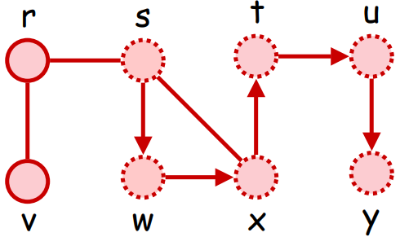
Graph Traversal: DFS, BFS
Depth First Search (DFS), 深度優先搜尋
將某條岔路探索到底後，再探索其他岔路

Slide 3
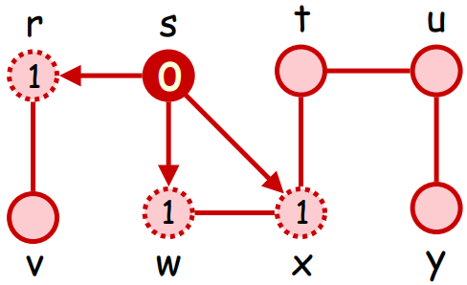
Graph Traversal: DFS, BFS
Breadth First Search (BFS), 廣度優先搜尋
同時探索所有岔路，並記錄每條岔路探索到哪

Slide 4
DFS, BFS - Implementation
節點目前狀態：未造訪、已造訪
造訪新的節點：只能造訪「未造訪」的節點

Slide 5
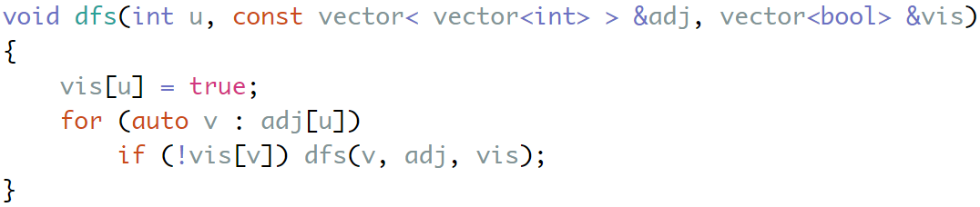
DFS - Implementation
利用遞迴，將某條岔路探索到底後，再探索其他岔路

Slide 6
DFS - Implementation
更新節點狀態
根據節點狀態決定是否造訪

Slide 7

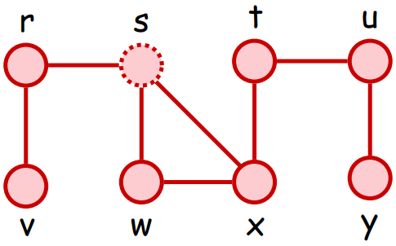
DFS - Example
visit order: s
function call: dfs(s)
In adj[s], find vis[w] = false, call dfs(w)

Slide 8
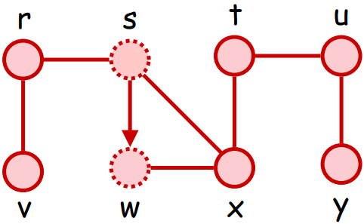
DFS - Example
visit order: s , w
function call: dfs(s) => dfs(w)
In adj[w], find vis[x] = false, call dfs(x)

Slide 9
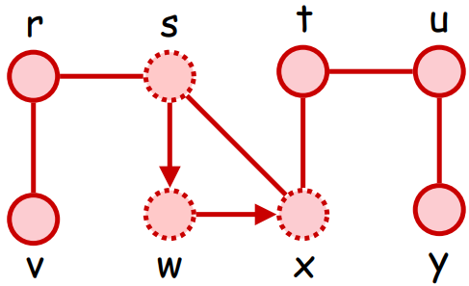
DFS - Example
visit order: s , w , x
function call: dfs(s) => dfs(w) => dfs(x)
In adj[x], find vis[t] = false, call dfs(t)

Slide 10
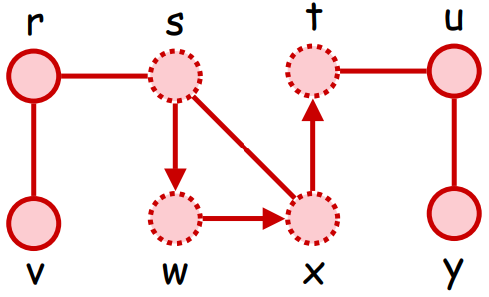
DFS - Example
visit order: s , w , x , t
function call: dfs(s) => dfs(w) => dfs(x) => dfs(t)
In adj[t], find vis[u] = false, call dfs(u)

Slide 11
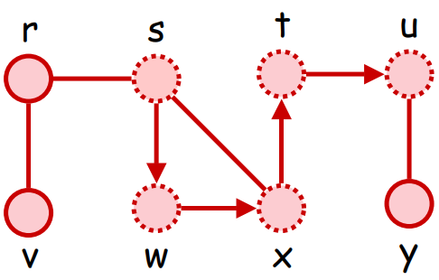
DFS - Example
visit order: s , w , x , t , u
function call: dfs(s) => dfs(w) => dfs(x) => dfs(t) => dfs(u)
In adj[u], find vis[y] = false, call dfs(y)

Slide 12
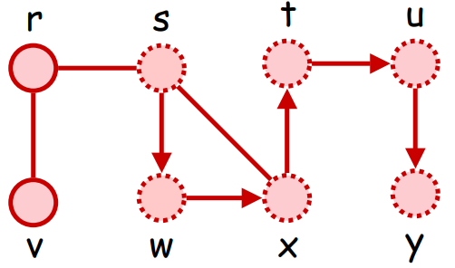
DFS - Example
visit order: s , w , x , t , u , y
function call: dfs(s) => dfs(w) => dfs(x) => dfs(t) => dfs(u) => dfs(y)
In adj[y], find all neighbors are visited, dfs(y) terminate

Slide 13
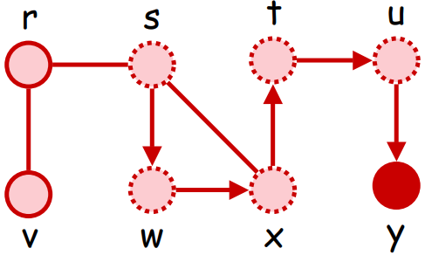
DFS - Example
visit order: s , w , x , t , u , y
function call: dfs(s) => dfs(w) => dfs(x) => dfs(t) => dfs(u)
In adj[u], find all neighbors are visited, dfs(u) terminate

Slide 14
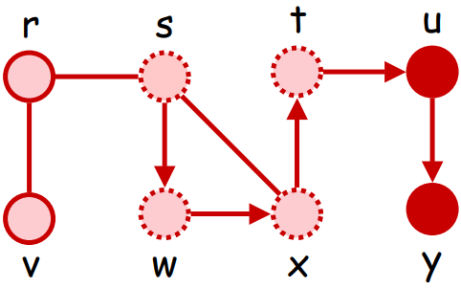
DFS - Example
visit order: s , w , x , t , u , y
function call: dfs(s) => dfs(w) => dfs(x) => dfs(t)
In adj[t], find all neighbors are visited, dfs(t) terminate

Slide 15
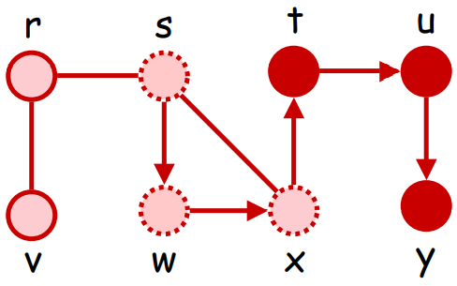
DFS - Example
visit order: s , w , x , t , u , y
function call: dfs(s) => dfs(w) => dfs(x)
In adj[x], find all neighbors are visited, dfs(x) terminate

Slide 16
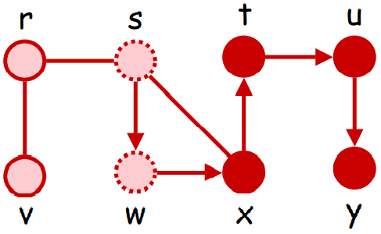
DFS - Example
visit order: s , w , x , t , u , y
function call: dfs(s) => dfs(w)
In adj[w], find all neighbors are visited, dfs(w) terminate

Slide 17
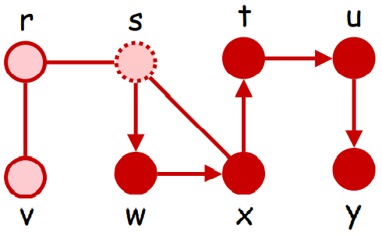
DFS - Example
visit order: s , w , x , t , u , y
function call: dfs(s)
In adj[s], find vis[r] = false, call dfs(r)

Slide 18
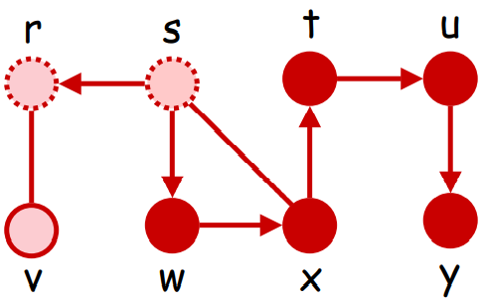
DFS - Example
visit order: s , w , x , t , u , y , r
function call: dfs(s) => dfs(r)
In adj[r], find vis[v] = false, call dfs(v)

Slide 19
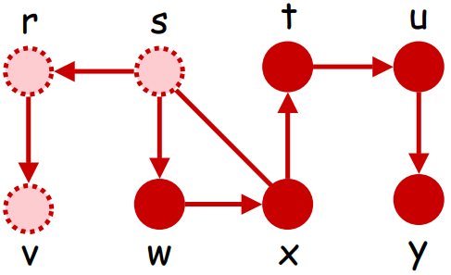
DFS - Example
visit order: s , w , x , t , u , y , r , v
function call: dfs(s) => dfs(r) => dfs(v)
In adj[v], find all neighbors are visited, dfs(v) terminate

Slide 20
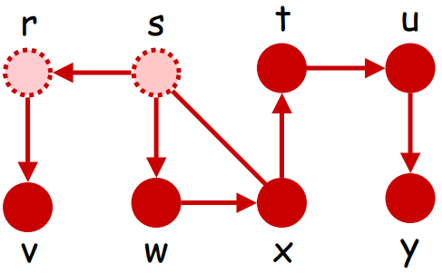
DFS - Example
visit order: s , w , x , t , u , y , r , v
function call: dfs(s) => dfs(r)
In adj[r], find all neighbors are visited, dfs(r) terminate

Slide 21
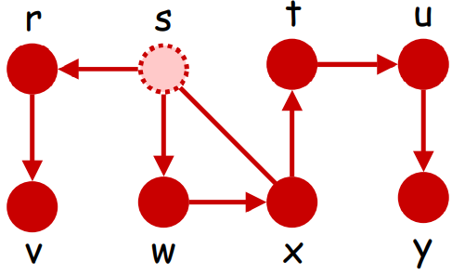
DFS - Example
visit order: s , w , x , t , u , y , r , v
function call: dfs(s)
In adj[s], find all neighbors are visited, dfs(s) terminate

Slide 22
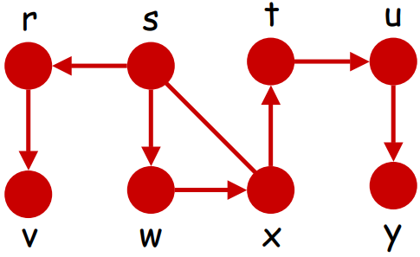
DFS - Example
visit order: s , w , x , t , u , y , r , v
function call: (empty)
All function call terminate, DFS end

Slide 23
DFS - Example
將某條岔路探索到底後，再探索其他岔路
visit order: s , w , x , t , u , y , r , v
第一條岔路： s , w , x , t , u , y
第二條岔路： s , r , v

Slide 24
DFS - Time complexity
Adjacency list
each vertex in the adjacency lists is examined at most once
O( |V| + |E| )
Adjacency matrix
determine all neighbors of specific vertex takes O( |V| )
at most |V| vertices are visited
O( |V| ^ 2 )

Slide 25
BFS - Implementation

Slide 26
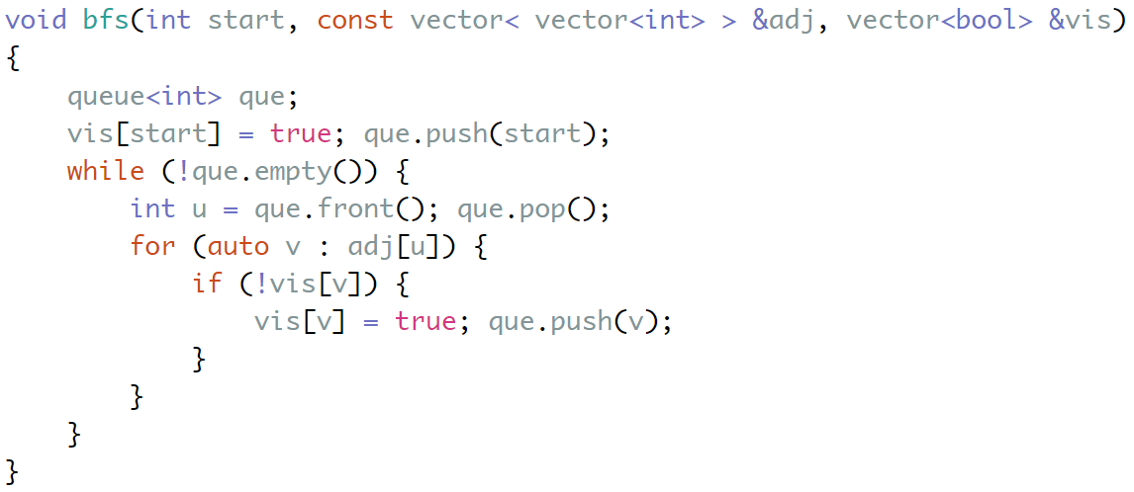
BFS - Implementation
利用 queue （先進先出），記錄每條岔路探索到哪，藉此同時探索所有岔路

Slide 27
BFS - Implementation
更新節點狀態
根據節點狀態決定是否造訪
更新節點狀態

Slide 28
BFS - Implementation

Slide 29
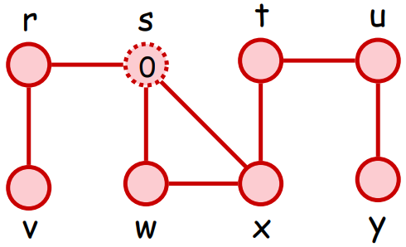
BFS - Example
visit order:
queue: (empty)
Initialize, push s into queue

Slide 30
BFS - Example
visit order: s
queue: s
pop queue, in adj[s], find vis[w] = vis[r] = vis[x] = false, push them into queue

Slide 31
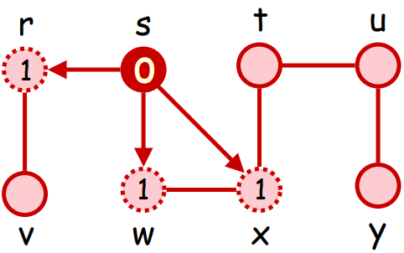
BFS - Example
visit order: s, w, r, x
queue: w, r, x
pop queue, in adj[w], find all neighbors are visited, do nothing

Slide 32
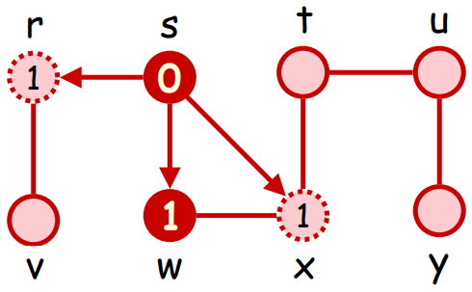
BFS - Example
visit order: s, w, r, x
queue: r, x
pop queue, in adj[r], find vis[v] = false, push it into queue

Slide 33
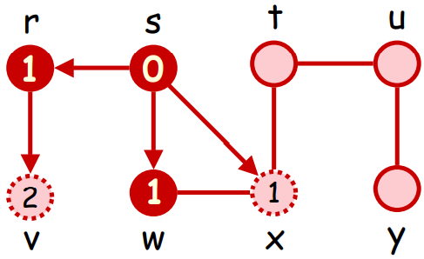
BFS - Example
visit order: s, w, r, x, v
queue: x, v
pop queue, in adj[x], find vis[t] = false, push it into queue

Slide 34
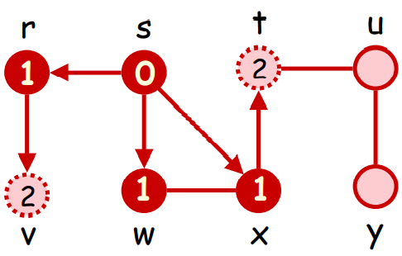
BFS - Example
visit order: s, w, r, x, v, t
queue: v, t
pop queue, in adj[v], find all neighbors are visited, do nothing

Slide 35
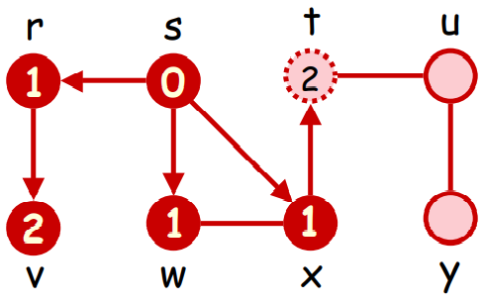
BFS - Example
visit order: s, w, r, x, v, t
queue: t
pop queue, in adj[t], find vis[u] = false, push it into queue

Slide 36
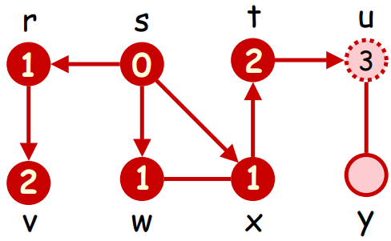
BFS - Example
visit order: s, w, r, x, v, t, u
queue: u
pop queue, in adj[u], find vis[y] = false, push it into queue

Slide 37
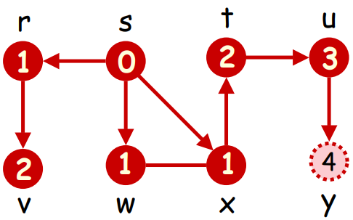
BFS - Example
visit order: s, w, r, x, v, t, u, y
queue: y
pop queue, in adj[y], find all neighbors are visited, do nothing

Slide 38
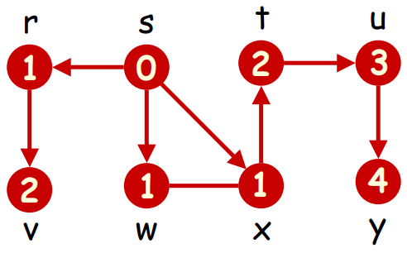
BFS - Example
visit order: s, w, r, x, v, t, u, y
queue: (empty)
The queue is empty, BFS end

Slide 39
BFS - Example
同時探索所有岔路，並記錄每條岔路探索到哪
visit order: s , w , r , x , v , t , u , y
第一輪探索： w , r , x
第二輪探索： v , t
第三輪探索： u
第四輪探索： y

Slide 40
BFS - Time complexity
Same as DFS

Slide 41
想想看
如果保證 graph 是一顆 tree ，能否不記錄「所有」 vertices 的被造訪狀態進行 DFS / BFS ?

Slide 42
in class sample codes
DFS:
http://codepad.org/UWX8hzzj

